Slide 1

Doub less Living!
The Gospel of
LUKE
That you may have certainty!

Slide 2
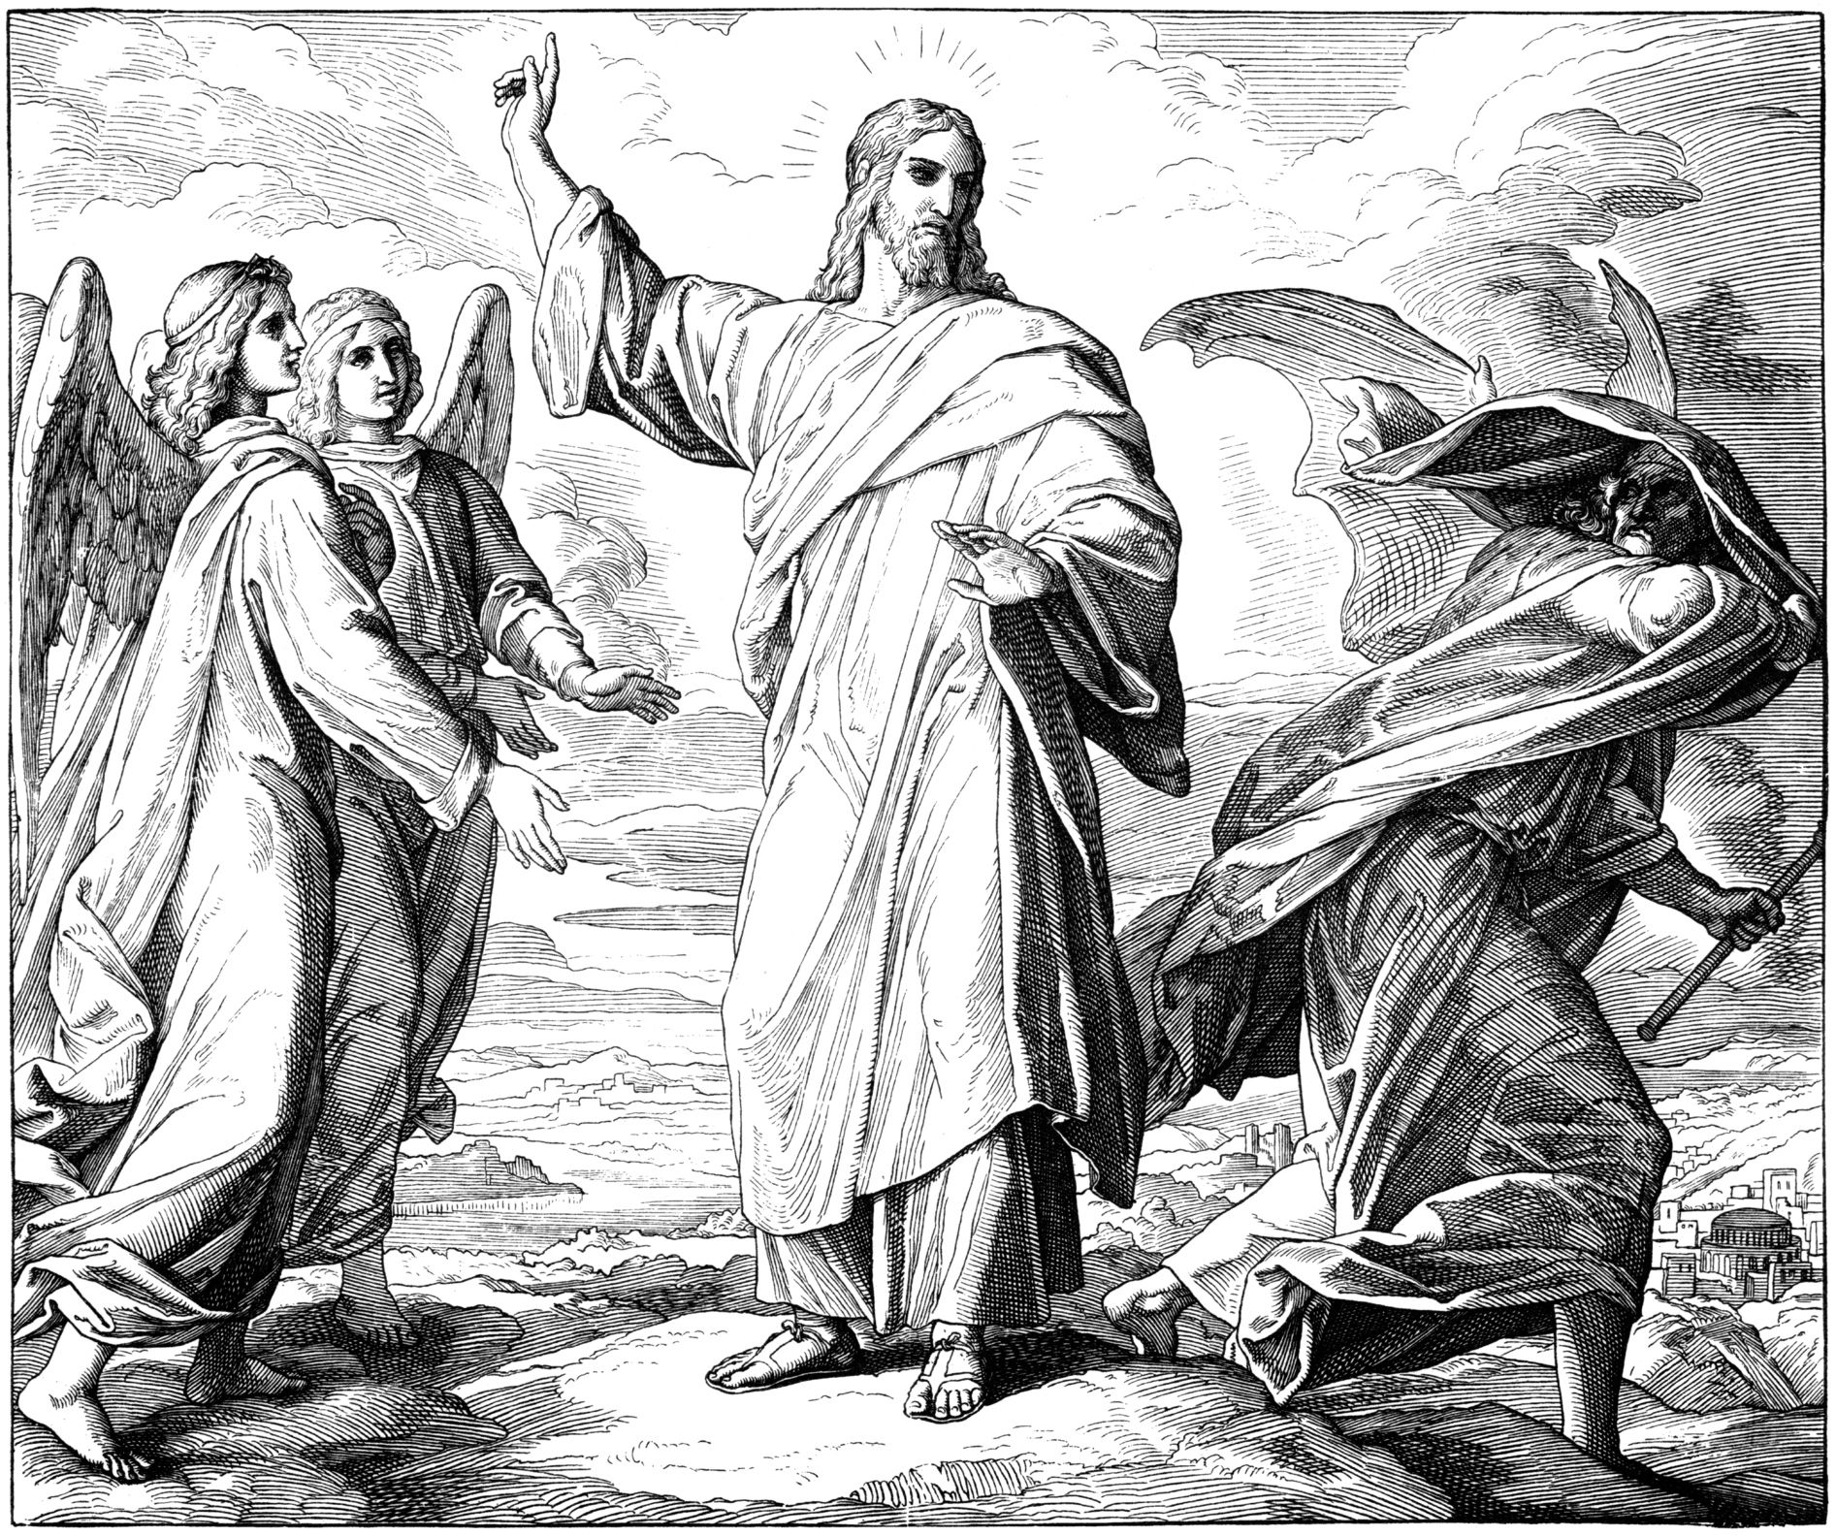
The Temptation of Jesus
Luke 4:1-13
Hebrews 4:14-16
James 1:2-3, 13-14
John 8:44
Ephesians 6:13-18
2 Corinthians 10:4-5

Slide 3
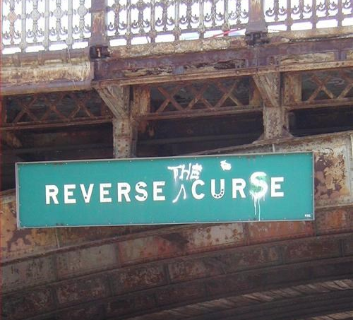
Have you seen this sign?
Where was it?
What did it mean?
Why is it gone now?
Notes:
West bound on Storrow Drive at the Longfellow Bridge in the back bay area of Boston near Fenway Park – reverse the curse of the Bambino

Slide 4
¹Then Jesus left the Jordan, full of the Holy Spirit, and was led by the Spirit in the wilderness ²for forty days to be tempted by the devil. He ate nothing during those days, and when they were over, he was hungry. ³The devil said to him, "If you are the Son of God, tell this stone to become bread." ⁴But Jesus answered him, "It is written: Man must not live on bread alone.“ ⁵So he took him up and showed him all the kingdoms of the world in a moment of time. ⁶The devil said to him, "I will give you their splendor and all this authority, because it has been given over to me, and I can give it to anyone I want. ⁷If you, then, will worship me, all will be yours." ⁸And Jesus answered him, "It is written: Worship the Lord your God, and serve him only." ⁹So he took him to Jerusalem, had him stand on the pinnacle of the temple, and said to him, "If you are the Son of God, throw yourself down from here. ¹⁰For it is written: He will give his angels orders concerning you, to protect you, ¹¹and they will support you with their hands, so that you will not strike your foot against a stone.“ ¹²And Jesus answered him, "It is said: Do not test the Lord your God." ¹³After the devil had finished every temptation, he departed from him for a time.
The Temptation of Jesus
Luke 4:1-13

Slide 5
The Temptation of Jesus
Luke 4:1-13
The 1st Temptation
¹ Then Jesus left the Jordan, full of the Holy Spirit, and was led by the Spirit in the wilderness ² for forty days to be tempted by the devil. He ate nothing during those days, and when they were over, he was hungry. ³ The devil said to him, "If you are the Son of God, tell this stone to become bread." ⁴ But Jesus answered him, "It is written: Man must not live on bread alone.“
❶ Why was Jesus tempted?
❷ What’s the difference between temptation & testing?
❸ When did the devil approach Jesus with this 1st temptation?
❹ How did Jesus resist the devil and what does that mean for us?
Notes:
Hebrews 4:14-16
James 1:2-3, 13-14
5. Ephesians 6:17 and 2 Cor. 10:4-5

Slide 6
The Temptation of Jesus
Luke 4:1-13
The 2nd Temptation
⁵ So he took him up and showed him all the kingdoms of the world in a moment of time. ⁶ The devil said to him, "I will give you their splendor and all this authority, because it has been given over to me, and I can give it to anyone I want. ⁷ If you, then, will worship me, all will be yours." ⁸ And Jesus answered him, "It is written: Worship the Lord your God, and serve him only."
❶ What did the devil offer Jesus; what was the root of the temptation?
❷ What was noteworthy about the devil’s approach to tempting Jesus?
❸ What does Scripture tell us elsewhere about the devil and his ways?
❹ So, what does that mean to us? How are we to know the truth?
Notes:
Jesus quoted Deut 6:13

Slide 7
The Temptation of Jesus
Luke 4:1-13
The 3rd Temptation
⁹ So he took him to Jerusalem, had him stand on the pinnacle of the temple, and said to him, "If you are the Son of God, throw yourself down from here. ¹⁰ For it is written: He will give his angels orders concerning you, to protect you, ¹¹ and they will support you with their hands, so that you will not strike your foot against a stone.“ ¹² And Jesus answered him, "It is said: Do not test the Lord your God." ¹³ After the devil had finished every temptation, he departed from him for a time.
❶ What was unique about the devil’s 3rd attempt?
❷ What double jeopardy did Jesus face with this attempt?
❸ How did Jesus avoid both traps with His response?
❹ What did the devil do after Jesus resisted him a third time?

Slide 8

Summation
The Temptation of Jesus
Luke 4:1-13
❶ Adam failed when tempted in the garden bringing a curse upon all mankind.
❷ The Israelites failed to trust God in the desert and failed to see and accept the Messiah.
❸ Jesus was tested in every way common to man, and still did not sin.
❹ Jesus’ sacrifice on the cross and victory over death reversed the curse of Adam.
❺ The Holy Spirit resides in every believer, giving us the power to resist sin.

Slide 9
Fighting Temptation
Keys
for
Ephesians 6:13-18
2 Corinthians 10:4-5
Suit Up!
Truth (belt)
Righteousness (armor)
Readiness (sandals)
Faith (shield)
Salvation (helmet)
Word of God (Sword)
Pray Up!
Power Up!
⁴since the weapons of our warfare are not worldly, but are powerful through God for the demolition of strongholds. We demolish arguments ⁵and every high-minded thing that is raised up against the knowledge of God, taking every thought captive to obey Christ.
If your sword is dull and your shield is weak, the armor will hold! Our righteousness and salvation are not our own, they come from the Truth!

Slide 10
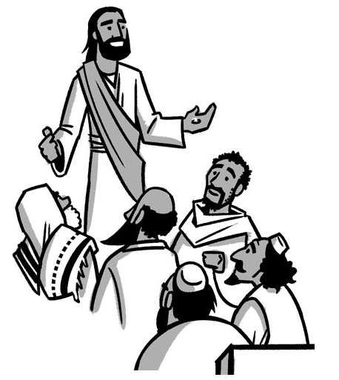
The Ministry of Jesus
Begins
Luke 4:14-44

